Slide 1
Results and lessons to be learned from the liberalisation of long distance bus and coach lines in Norway

Slide 2
High passenger growth in 15 years – some stagnation in the last 3 years

Slide 3
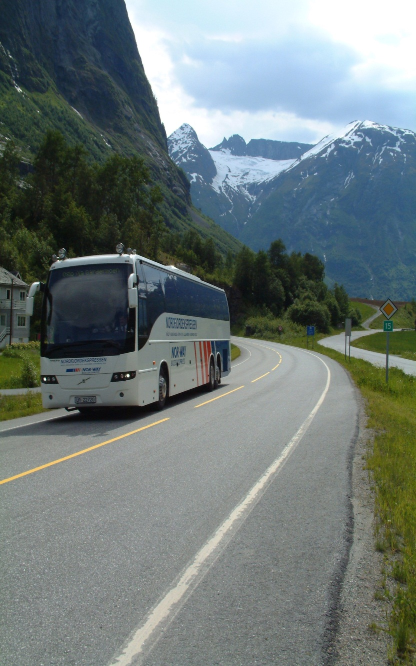
High costumer satisfaction over time - express bus scores higher then ordinary public transport

Slide 4
Development in Express bus market from 2000

Slide 5
Conclusions from a new study from Institute of Transport Economics
Express bus industry has grown after liberalisation (1998-2003). Stagnation and small decline slightly from 2007/2008
In general, the routes are commercially-driven. But there is an element of grant
Important services in rural areas when it is complementing the public transport offered by the county.
The express bus system gives favourable economic benefit for the society

Slide 6
Driving forces behind the successful development in the market
Innovative entrepreneurs who were willing to take risks
Creation of new routes
Establishment of new concepts
Cooperation with the county on routes
Express bus = local transport in area wit low population density
PTAs buy capacity (seats) for pupils
Liberalisation of the access to the market

Slide 7
What happened ?
Allowed to compete with the railway after the permission was given.
Full liberalisation in two steps
Free to compete with railway in eastern Norway
Free access to market in the whole country
Competitions from low cost airline, train and PTA taking over some lines
1

Slide 8
Conclusions
The bus industry can and will make new and attractive express bus services if the conditions are right
The market and competition functioning, it gives more passengers
between modes of transport
between different express bus services
Cooperation between PTA and exspressbuscompanies are important
Terminals and travel information
Rural areas

